Slide 1
ng-bootcamp
Day 1

Slide 2
Code
https://github.com/pmaccart/ng-bootcamp

Slide 3
Topics
Application Bootstrap
Static Templates
Root Scope
Dynamic Templates
Controllers
Directives
Data Binding
Event Handling
Forms

Slide 4
Why AngularJS
Declarative UI
Extensible HTML
Dependency Injection
Bidirectional Data Binding
Testability

Slide 5
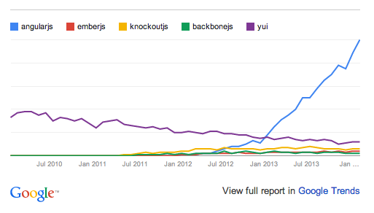

Slide 6
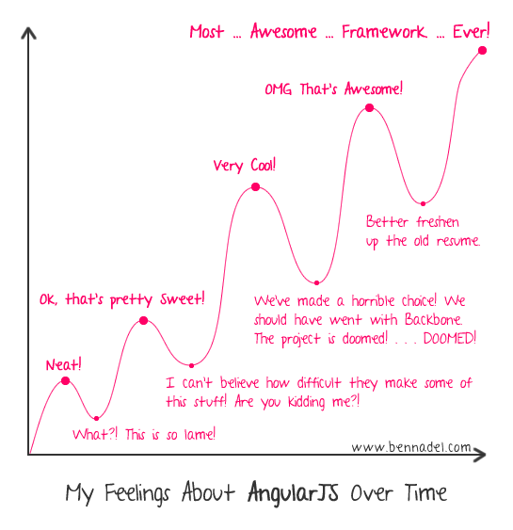

Slide 7
AngularJS
Declarative DOM interactions
Extended HTML vocabulary
Bidirectional Data Bindings
Focus on Testability

Slide 8
Application Bootstrap
Load JS dependency
Define root application element (ngApp directive)
AngularJS will:
  Create new injector for dependency injection
  Create a new Root Scope
  Compile the DOM starting with the ngApp element

Slide 9
<!doctype html>
<html lang="en" ng-app>
<head>
<meta charset="utf-8">
<title>ng-bootcamp - Day 1</title>
</head>
<body>
<h1>{{'Hello from AngularJS!'}}</h1>
<script src="bower_components/angular/angular.min.js"></script>
</body>
</html>

Slide 10
// TODO
Create base application
Use Bower to install Angular dependency
  bower install --save angular
Use Bower to install Twitter Bootstrap dependency
  bower install --save bootstrap
Setup base index.html page (copy from previous slide)

Slide 11
Checkpoint
git checkout -f day-1/step-0

Slide 12
ng-app
Points AngularJS to the root DOM element of the application
Allows for only using Angular on small sub-sections of a page

Slide 13
Bindings and Expressions
Double-curly braces denote a binding
Bindings contain an expression
{{ expression }}
Evaluated in the context of the $scope object
Support simple expressions and forgiving attribute evaluation, but no control flow statements
  {{ ‘Hello’ + ‘ ‘ + ‘World!’ }}
  {{ model.person.firstName }}
    Won’t throw an exception if model or person is null

Slide 14
Controllers
Constructor functions that take in a $scope paramter
Responsible for augmenting the scope
Attached to an element (view) via ng-controller directive
Injectable

Slide 15
Scope
Act as the model; execution context for AngularJS expressions in the templates
Single $rootScope created for an application
Hierarchical arrangement – single $rootScope object for application, with nested child scopes attached to DOM elements
  Child scopes can either prototypically inherit from their parent, or be isolated
Child scopes generally created by directives (ng-controller, ng-repeat, etc.)

Slide 16
Dynamic Expressions
Angular expressions have access to all properties on the scope
  Properties for read/write data access
  Functions for event handlers
$scope.name = 'Phil';
<div>{{name}}</div> // <div>Phil</div>
Null-safe
  Won’t throw exception if parent property is null
  {{model.my.null.property.name}} // won’t bomb

Slide 17
<!doctype html>
<html lang="en" ng-app>
<head>
<meta charset="utf-8">
<title>ng-bootcamp - Day 1</title>
</head>
<body ng-controller="MyController">
<h1>{{'Hello ' + name}}</h1>
<script src="bower_components/angular/angular.js"></script>
<script src=”app/app.js"></script>
</body>
</html>
// app.js
function MyController($scope) {
$scope.name = 'Phil';
}

Slide 18
Unit Testing
Primary focus of AngularJS
Isolation of DOM interaction to directives allows for easy testing of services and controllers
Dependency injection allows for easy mocking of dependencies

Slide 19
// app.js
function MyController($scope) {
$scope.name = 'Phil';
}
// app.spec.js
describe('MyController', function() {
var controller, scope;
beforeEach(function() {
scope = {};
controller = new MyController(scope);
})
it('should set the name property on the scope', function() {
expect(scope.name).toBe('Phil');
});
});
Notes:
module(‘ngBootcamp’); // load the module we want to test
Inject(function ($controller, $rootScope){…}); // wrap the provided function into an injectible function, allowing dependencies to be provided by the $injector
$controller(controllerName, locals); // controller service just loads the constructor function via the injector, then calls the function with its dependencies first from the locals object, then loading everything else from the $injector

Slide 20
Karma Test Runner
Built by AngularJS team
Test harness for JavaScript unit tests
Supports multiple browsers, headless PhantomJS
Capture browsers automatically or manually
Instruct Karma to start browsers on host machine (Chrome, FF, Safari, IE, Opera, PhantomJS)
Navigate browser to Karma server URL (useful for mobile devices)

Slide 21
Karma
Installation
  npm install -g karma-cli karma
  npm init # run this if you don’t have a package.json file already
  npm install --save karma-jasmine karma-chrome-launcher
Configuring Karma
  karma init
    Creates karma.conf.js
    Port, test browsers, files to load
Running Karma
  karma start karma.conf.js

Slide 22
// TODO
Create Controller in app.js
Set name property on $scope
Add ng-controller directive in index.html
Display name
Add unit test for controller

Slide 23
Checkpoint
git checkout -f day-1/step-1

Slide 24
Scope Inheritance
Child Scopes prototypically inherit from parent scopes based on nesting in DOM
  Exception: Isolote scopes
  Controller instances do not prototypically inherit – must do this manually!
All scopes inherit from $rootScope
Useful for cases like multi-step form wizards
  Store model on parent controller, let each step have its own child controller that augments the model on the $scope
<div ng-controller="ParentController">
<div ng-controller="ChildController"></div>
<div ng-controller="ChildController"></div>
</div>

Slide 25
// TODO
Create two controllers, ParentController and ChildController
ParentController should set a ‘parentName’ property on the scope
ChildController should set a ‘childName’ property on the scope
Attach ParentController to DOM element, and display parent name
Attach ChildController to DOM element that is child of parent controller, display parent name AND child name

